Slide 1
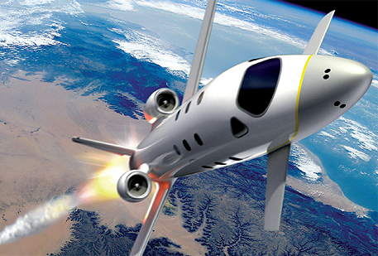

FDIR Spacecraft fault protection system
Project 2
OP6
Architectural
Euro Team
Alauzet Pierre, Ahvenniemi Mikko,
Colin Julien, Starck Benoit
CS554 - Design for Software &Systems

Slide 2
Table of Contents
Background
Architectural design
Utility tree & prioritized scenarios
Architectural approach identification + global scheme
Architectural decisions (type and architecture)
Proposed FDIR architecture throug ACMEStudio
Architectural analysis
Strenghs & weaknesses of our architecture (about advantages & disadvantage of choosen family → key decisions)
Quality attributes goal (utility tree & scenarios)

Slide 3
Atam reminder
1
2
Present FDIR business drivers
3
Present FDIR architecture made through ACME
4
5
6
7
8
9
Identify FDIR architectural approaches made through ACME
Generate FDIR quality attribute utility tree
Analyze architectural FDIR approaches made through ACME
Brainstorm and prioritize scenarios of FDIR requirement
Analyze FDIR architectural approaches made through ACME
Present FDIR ATAM assessment results
Present the ATAM

Slide 4
Project 2 progresses
Describe & design the architecture of a software system
Specify the system: FDIR fault protection system
Propose an architecture
Utility tree (ATAM)
Prioritized scenarios (ATAM)
Critical architectural decisions (compare the decisions with alternative choices for those key decisions
Document and explain the architecture
Make an architecture analysis
Do we meet the quality attributes goals ? Do we satisfy the requirements as portrayed in the utility trees and scenarios
What are the strenghs and weaknesses of our architecture ? (ATAM)
Weaknesses of our system thru our archi
Compare 1 or 2 others archi

Slide 5
references
David S. Wile, ACME: An Interchange Language for Architecture Representation
http://www.cs.cmu.edu/~acme/, ACME websites
http://en.wikipedia.org/wiki/Architecture_description_language, ADL wikipedia page
[KKC00] R. Kazman, M. Klein, P. Clements, ATAM: A Method for Architecture Evaluation, CMU/SEI-2000-TR-004, Software Engineering Institute, Carnegie Mellon University, 2000.

